Slide 1
ENTERTAINER DATA ANALYTICS
Submitted by: Chandan Bhattacharya

Slide 2
Problem Statement
The entertainment industry generates vast amounts of data across various platforms, including social media, streaming services, and fan interactions. However, this data is often unstructured, siloed, and underutilized, making it difficult for stakeholders to extract actionable insights.
Key challenges include:
Understanding Audience Preferences: The difficulty in accurately gauging audience preferences and sentiments toward entertainers and their content.
Predicting Popularity Trends: The challenge of forecasting future trends in entertainer popularity based on historical data.
Optimizing Engagement Strategies: The need for data-driven strategies to enhance fan engagement and increase the reach of entertainers.

Slide 3
Objectives
Extract Actionable Insights
Analyze data from multiple sources to identify trends in audience preferences and behavior towards entertainers.
Predict Future Trends
Utilize predictive modeling techniques to forecast the future popularity of entertainers based on historical data.
Create Interactive Visualizations
Develop visual tools that allow stakeholders to easily understand and act upon the insights derived from the data.

Slide 4
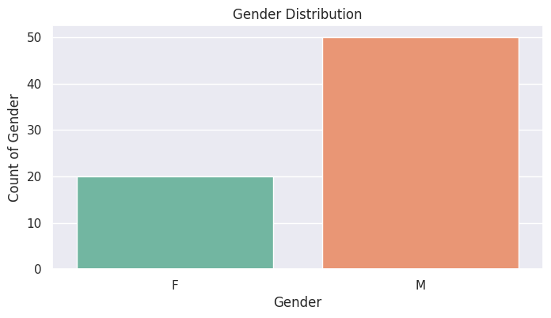
Showing Gender Distribution
Here let us take a look at the Male and Female Entertainer proportion of the dataset.

Slide 5
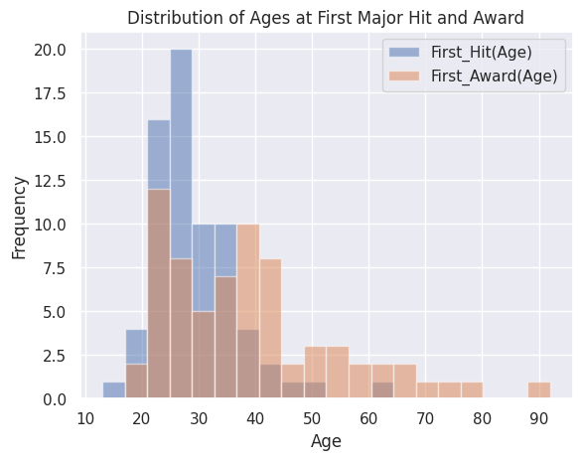
Distribution of Ages at First Major Hit and Award of Entertainer
The most Entertainers get have their first major hit between the ages 20-30

Slide 6
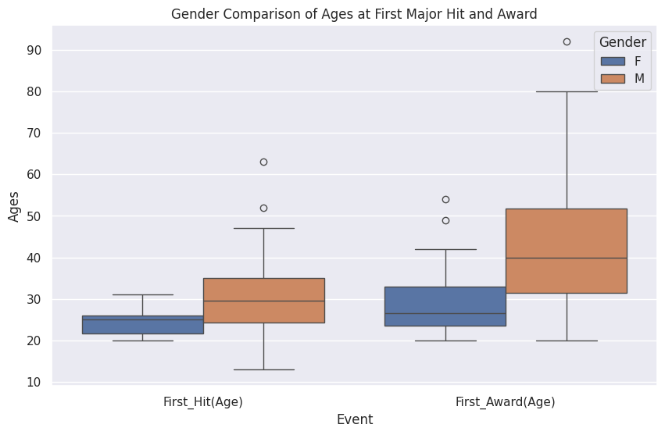
Gender Comparison of Ages at First Major Hit and Award
The women seem to have their first hit at the age range of early to late 20s whereas for men this range is from mid 20s to mid 30s.

Slide 7
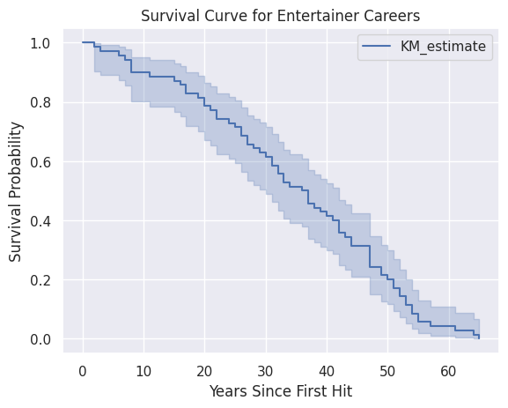
Survival Curve for Entertainer Careers

Slide 8
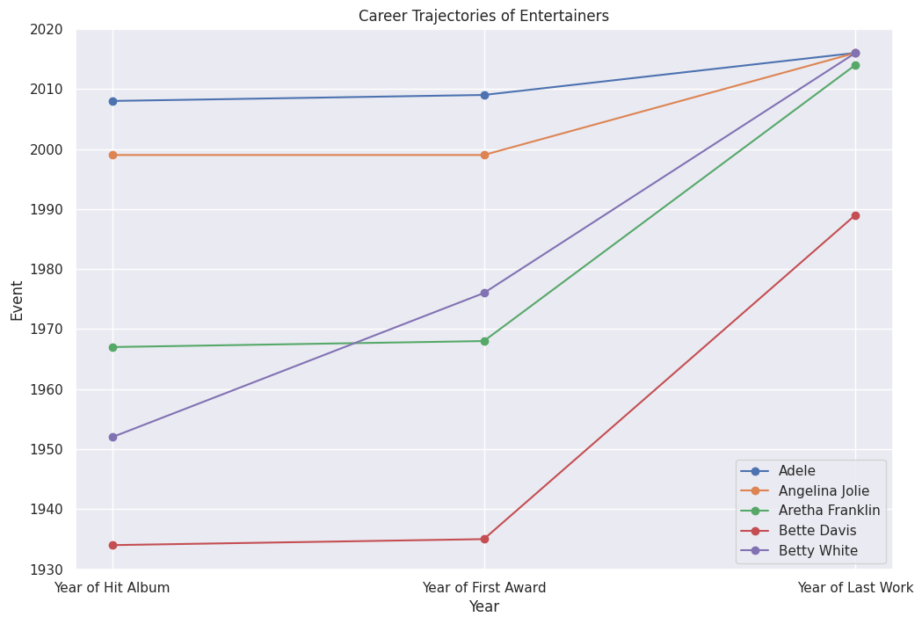
Career Trajectories of Entertainers

Slide 9
Conclusion
Enhanced Understanding of Audience Preferences:
The analysis provided deep insights into audience behavior, preferences, and engagement patterns, helping to tailor content and strategies to better meet their expectations.
Insights:
The entertainment industry celebrates excellence through prestigious awards like Oscars, Emmys, and Grammys. This report analyzes top entertainers, examining their profession, gender distribution, and awards won. It highlights key trends and recognizes the exceptional talents of leading figures in the industry, providing insights into their remarkable achievements and contributions.

Slide 10
Thank You

